Slide 1


Lantus Brazil Baseline Model
Presentation to Sanofi-Aventis in Brazil
IMS Management Consulting
08 Feb 2010

Slide 2
Lantus baseline model estimates – (Retail Sales)
Variable | Estimate | Standard Error | DF | T Value | P Value | retention rate
Intercept | 0.557 | 0.394 | 16 | 1.416 | 0.176
Calls_SPECs | 0.244 | 0.450 | 16 | 0.542 | 0.596 | 0.85
Speakers | 0.039 | 0.059 | 16 | 0.667 | 0.514 | 0.6
Lantus Time Trend (from Oct07 to Sep09) | 0.125 | 0.056 | 16 | 2.233 | 0.040
Lantus Solostar Launch Trend (since Dec08) | 0.053 | 0.013 | 16 | 4.062 | 0.001
February (Feb08 and Feb09) | -0.011 | 0.003 | 16 | -3.612 | 0.002
Pre-price increase effect (Mar09) | 0.005 | 0.002 | 16 | 2.807 | 0.013
Post-price increase effect (Apr & May of 08 and 09) | -0.008 | 0.005 | 16 | -1.560 | 0.138
Lantus Time Trend controls the time trend impact on Lantus retail sales.
Lantus Solostar Launch Trend controls Solostar launch impact on Lantus retail sales (see slide5 for complementary info).
February controls the negative impact on Lantus retail sales due to less working days and carnival holidays .
Pre-price increase effect takes care of the obvious positive impact on Lantus sales in Mar09 before price increased in the same month.
Post-price increase effect takes care of the negative impact on Lantus sales after price increased in Mar of every year.
Lantus Brazil Promo Mix Optimization - Jan 2010 •
<number>

Slide 3
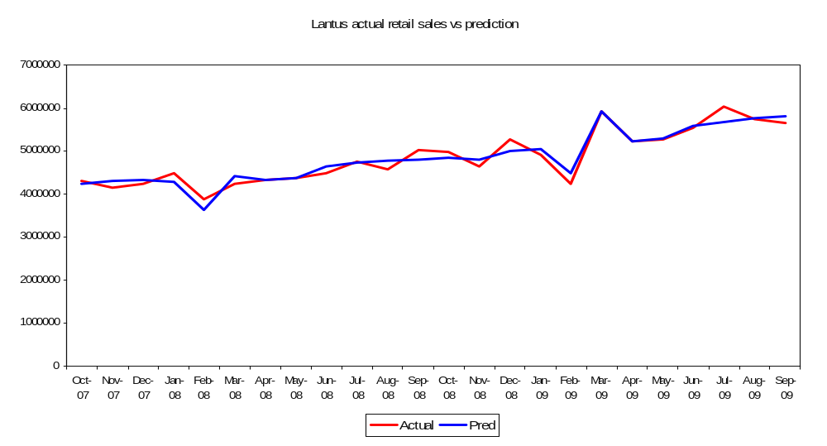
Lantus baseline model fit – (Retail Sales)
R-Square: 0.93
Durbin Watson Statistics: 2.37
R-Square is a measure of the overall goodness of fit of a model expressed as the percentage of historical variation explained
The Durbin-Watson (DW) statistic tests whether the errors in a model are distributed randomly. It can take a value between 0 and 4 with a value close to 2 being the aim. Values substantially below 2 show evidence of positive serial correlation, whilst substantially above 2 show evidence of negative serial correlation.
Lantus Brazil Promo Mix Optimization - Jan 2010 •
<number>

Slide 4
Market events not detected in the model
  Competitor launch: Levemir, Exubera, Januvia and Galvus were all launched half year before Oct07, so, very small or no negative impact was expected during the modeling time period (Oct07-Sep09). (See a complementary table for Exubera sales on Slide 7)
  Humalog and Apidra were launched in Aug08 and Dec08 respectively, which was encountered the launch of SoloStar (Nov08). So, the negative impact was highly statistically insignificant. (See table below and complementary info of Humalog sales on Slide 6)
  Competitor discontinuation: the discontinuation of Novolin multiple dosage forms and Biohulin multiple dosage forms happened before Feb07 and May07 respectively. So, very small or no positive impact was expected during the modeling time period (Oct07-Sep09)
  Pre price increase effect in Mar08 – the price increase rate is only 2.52% in this month which is much less compared to that in Mar2009 (5.23%). Model shows insignificant positive impact in this month (see table below).
  ADA guideline (Jun08): It is a guideline of insulin use and affects all insulin products, not only Lantus. So it won’t change Lantus sales a lot relatively.
  Backorder for wholesalers – which happened in Apr06, and hence no impact was expected during the modeling time period (Oct07-Sep09) .
Variable | Estimate | StdErr | tValue | Probt
Intercept | 0.514501314 | 0.286623671 | 1.795041258 | 0.091559
Calls_SPECs | 0.293273491 | 0.300346918 | 0.976449143 | 0.343375
Lantus Time Trend (Oct07 to Sep09) | 0.162280252 | 0.070439988 | 2.303808633 | 0.034983
Lantus Solostar Launch Trend (since Dec08) | 0.054818312 | 0.014451542 | 3.793249939 | 0.001595
February (Feb08 and Feb09) | -0.011845788 | 0.003914074 | -3.02645953 | 0.008024
Post-price increase effect (Apr & May of 08 and 09) | -0.008668751 | 0.005341211 | -1.622993485 | 0.124126
Pre-price increase effect (Mar08 and 09) | 0.002422051 | 0.003462042 | 0.699601684 | 0.494223
Humalog and Apridra launch | -0.005833243 | 0.008059291 | -0.723791055 | 0.479644
Lantus Brazil Promo Mix Optimization - Jan 2010 •
<number>

Slide 5
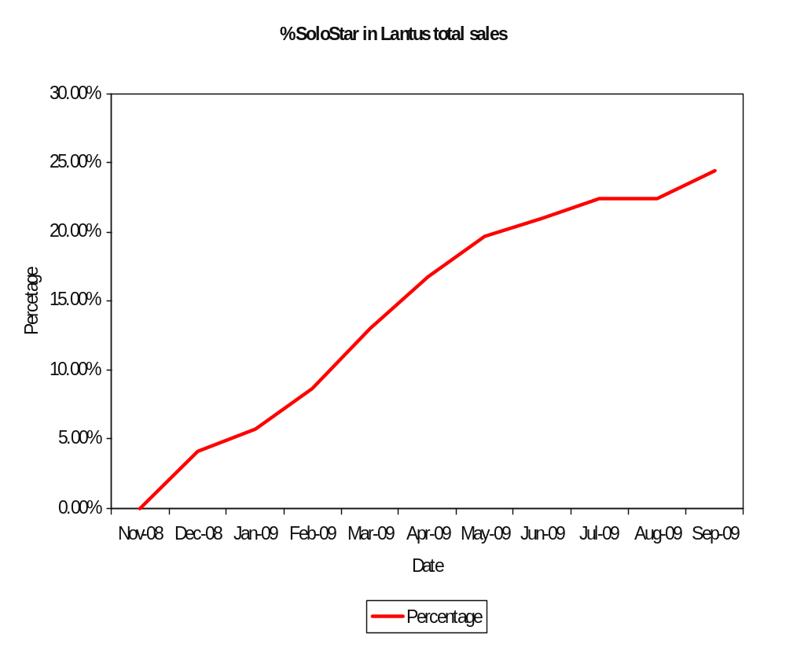
SoloStar sales proportion of Lantus total sales since its launch
Date | SoloStar (reais) | Lantus all strength (reais) | % solostar of total | Note
11/1/2008 | 0.00 | 4639657.75 | 0.00% | launch of SoloStar
12/1/2008 | 218782.92 | 5272788.19 | 4.15% | Started to sell in Dec08
1/1/2009 | 284320.43 | 4920763.68 | 5.78%
2/1/2009 | 370006.03 | 4244787.70 | 8.72%
3/1/2009 | 772743.20 | 5914370.58 | 13.07%
4/1/2009 | 875534.25 | 5237828.99 | 16.72%
5/1/2009 | 1039250.53 | 5278266.00 | 19.69%
6/1/2009 | 1166955.71 | 5543644.24 | 21.05%
7/1/2009 | 1358117.07 | 6044220.73 | 22.47%
8/1/2009 | 1284984.14 | 5733537.24 | 22.41%
9/1/2009 | 1382151.12 | 5659741.56 | 24.42%
Note: SoloStar sales keep climbing up since it was launched. This climbing trend is not only driven by promotional efforts but also by the launch effect.
Lantus Brazil Promo Mix Optimization - Jan 2010 •
<number>

Slide 6
Humalog Mix 50 sales compared with Lantus sales
Date | HUMALOG MIX 50 (reais) | Lantus SoloStar (reais) | Lantus All Strength (reais) | Ratio of Humalog mix to SoloStar | Ratio of Humalog mix to Lantus all | Note
1-May-08 | 102150.77 | 0 | 4370802.57 | N/A | 2.34% | Humalog mix 50 launched
1-Jun-08 | 0.00 | 0 | 4478969.11 | N/A | 0.00%
1-Jul-08 | 0.00 | 0 | 4751935.68 | N/A | 0.00%
1-Aug-08 | 177323.61 | 0 | 4566562.32 | N/A | 3.88%
1-Sep-08 | 130533.78 | 0 | 5017497.49 | N/A | 2.60%
1-Oct-08 | 168049.97 | 0 | 4977577.36 | N/A | 3.38%
1-Nov-08 | 140369.49 | 0 | 4639657.75 | N/A | 3.03% | Lantus SoloStar launched
1-Dec-08 | 50724.11 | 218782.92 | 5272788.19 | 23.18% | 0.96%
1-Jan-09 | 45525.24 | 284320.43 | 4920763.68 | 16.01% | 0.93%
1-Feb-09 | 60278.79 | 370006.03 | 4244787.7 | 16.29% | 1.42%
1-Mar-09 | 89223.86 | 772743.2 | 5914370.58 | 11.55% | 1.51%
1-Apr-09 | 89726.41 | 875534.25 | 5237828.99 | 10.25% | 1.71%
1-May-09 | 81096.00 | 1039250.53 | 5278266 | 7.80% | 1.54%
1-Jun-09 | 98059.19 | 1166955.71 | 5543644.24 | 8.40% | 1.77%
1-Jul-09 | 105796.80 | 1358117.07 | 6044220.73 | 7.79% | 1.75%
1-Aug-09 | 101779.20 | 1284984.14 | 5733537.24 | 7.92% | 1.78%
1-Sep-09 | 118147.20 | 1382151.12 | 5659741.56 | 8.55% | 2.09%
Note: Humulog Mix 50 is less than 1/5 of SoloStar, and only accounts for less than 5% of Lantus all strengths. Very limited launch effect was expected.
Lantus Brazil Promo Mix Optimization - Jan 2010 •
<number>

Slide 7
Exubera sales compared with Lantus sales
Date | EXUBERA (reais) | Lantus all strength (reais) | Ratio of Exubera to Lantus all | Note
1-May-07 | 375207.67 | 3501131.53 | 10.72% | Exubera launched
1-Jun-07 | 110822.42 | 3719793.35 | 2.98%
1-Jul-07 | 152052.99 | 3693773.82 | 4.12%
1-Aug-07 | 145234.71 | 3944004.21 | 3.68%
1-Sep-07 | 179438.73 | 3625302.15 | 4.95%
1-Oct-07 | 210377.32 | 4308311.17 | 4.88% | Start month of model period
1-Nov-07 | 158338.05 | 4146816.19 | 3.82%
1-Dec-07 | 89095.2 | 4234107.73 | 2.10%
1-Jan-08 | 63938.9 | 4477399.44 | 1.43%
1-Feb-08 | 38514.01 | 3875151.44 | 0.99%
1-Mar-08 | 32517.44 | 4248171.01 | 0.77% | Exubera discontinued
1-Apr-08 | 16500.82 | 4326445.84 | 0.38%
1-May-08 | 12212.47 | 4370802.57 | 0.28%
1-Jun-08 | 10105.82 | 4478969.11 | 0.23%
1-Jul-08 | 14710.33 | 4751935.68 | 0.31%
1-Aug-08 | 746.69 | 4566562.32 | 0.02%
1-Sep-08 | 0 | 5017497.49 | 0.00%
Note: Exubera sales is only less than 5% of Lantus all strength since Oct07. So, very limited launch and discontinuation impact on Lantus sales was expected.
Lantus Brazil Promo Mix Optimization - Jan 2010 •
<number>

